Slide 1
"Global Trust Analysis: Insights Across Nations and Professions“
"Examining Trends in Trust Levels Across Neighborhoods, Governments, and Key Professions Worldwide "Examining Trends in Trust Levels Across Neighborhoods, Governments, and Key Professions Worldwide"
By: Ethan Shipman, Andrew Jaynes,
Seth Carter, Rafaela Peterson

Slide 3
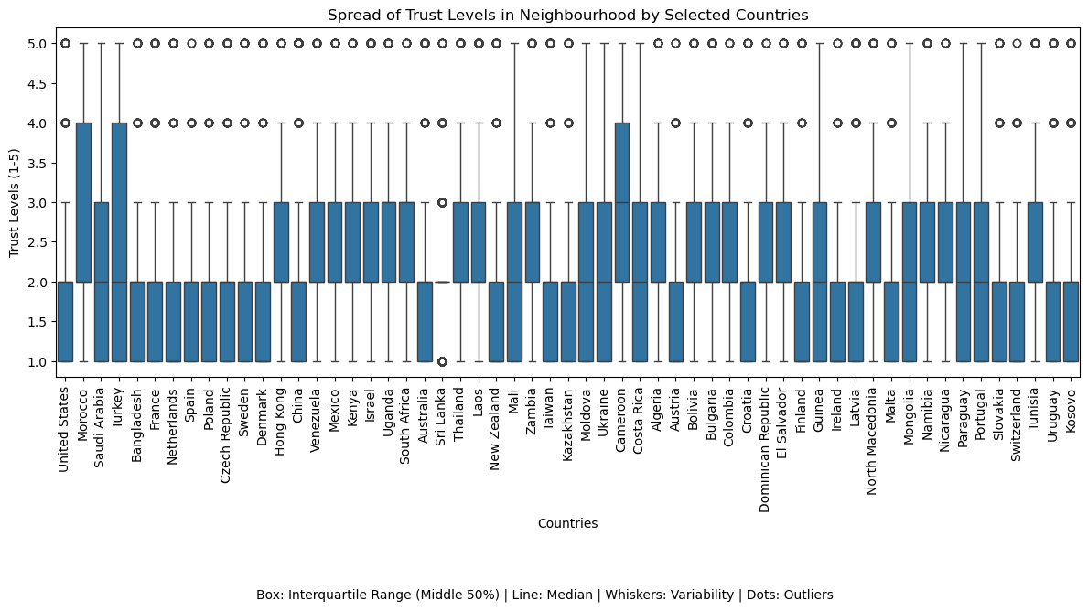
Trust Levels in Neighborhoods Across Selected Countries
Overview: The box plot shows neighborhood trust levels (1 to 5) across various countries, highlighting variability and patterns.
Key Insights: High Variability: Countries like the United States and Morocco show wide ranges of trust levels. Consistency: Countries like France and Sri Lanka have more uniform trust levels. Outliers: Some countries have extreme trust levels, indicating unique perspectives.
Implications: The patterns suggest cultural, economic, or social influences on trust. This variability could connect to trust in other societal sectors.

